Slide 1
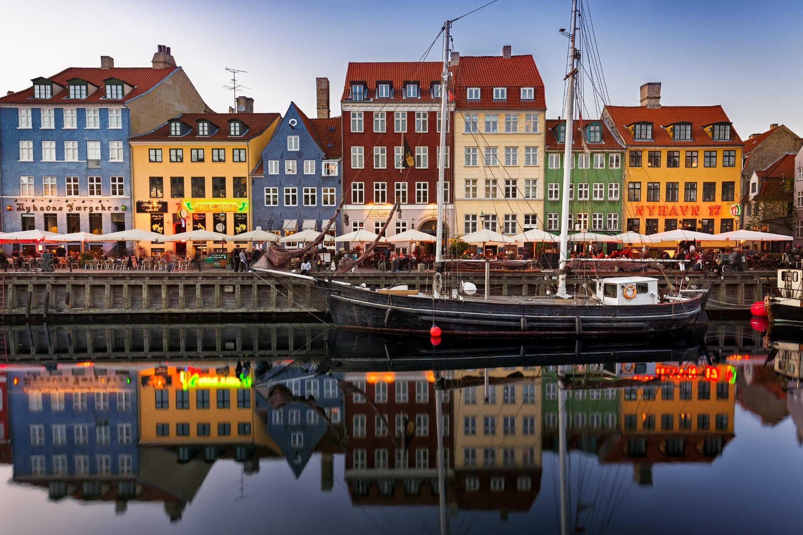


The Apache Way and collaborative development
Ismaël Mejía. @iemejia

Slide 2
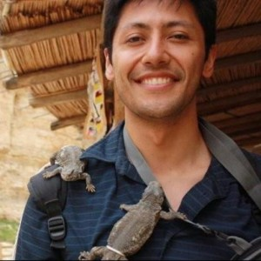
Who am I ?
@iemejia Software Engineer Apache Beam PMC / Committer Apache Software Foundation (ASF) member Open and free knowledge enthusiast

Slide 3
Disclaimer
Very often, the Apache Software Foundation does not have an official view on things - we are a group of individuals with varying opinions.
What follows is my own personal view.

Slide 4
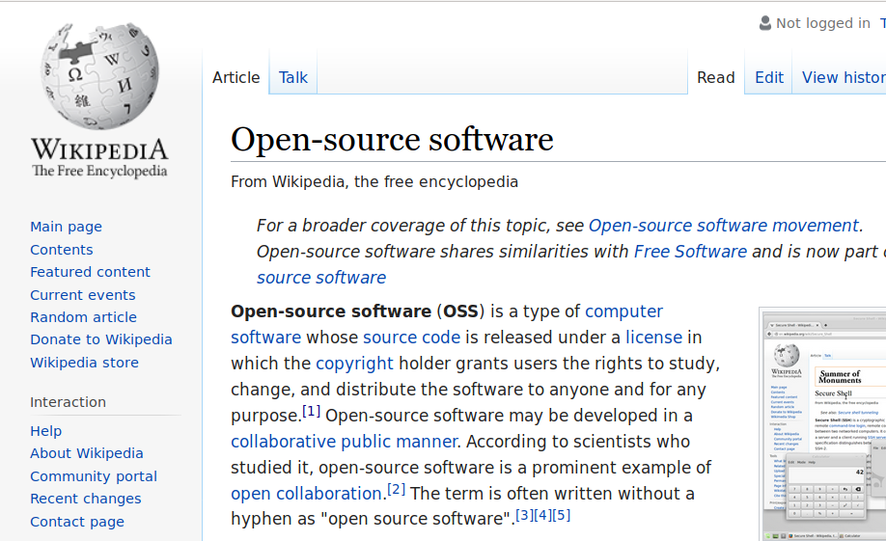
Open-source software
Open source success is not only about the source
Notes:
What is success ? Being healthy or being popular.

Slide 5
Software is easy. People are HARD
It is easier than ever today to create and collaborate online.
'Free' infrastructure: github, gmail, google groups, google docs, skype, slack, IRC, etc.
but, the health of an open source project is not only about technical requirements or the source:
Users: Experience, Documentation, Feedback
Developers: Maintainers (Bus factor)
Policies / Project Governance / Decision Making
Documentation
Legal matters: IP, Corporate Influence, branding
Awareness: Communication / Marketing
Notes:
Will a project fail if one of its members is hit by a bus?
"in case they get hit by a bus". It is also known as the lottery factor, truck factor,^{[1]} bus/truck number, or lorry factor.

Slide 6
What would you expect from a project where...
Multiple people must agree to take important decisions
People work from different parts in the world in different languages and with independent agendas
We deal with people with really different level of knowledge and background (professionals and beginners)
Institutions involved have different levels of resources / funding
Everything can be viewed, judged and modified by others
Somebody can engage in a task and just disappear

Slide 7
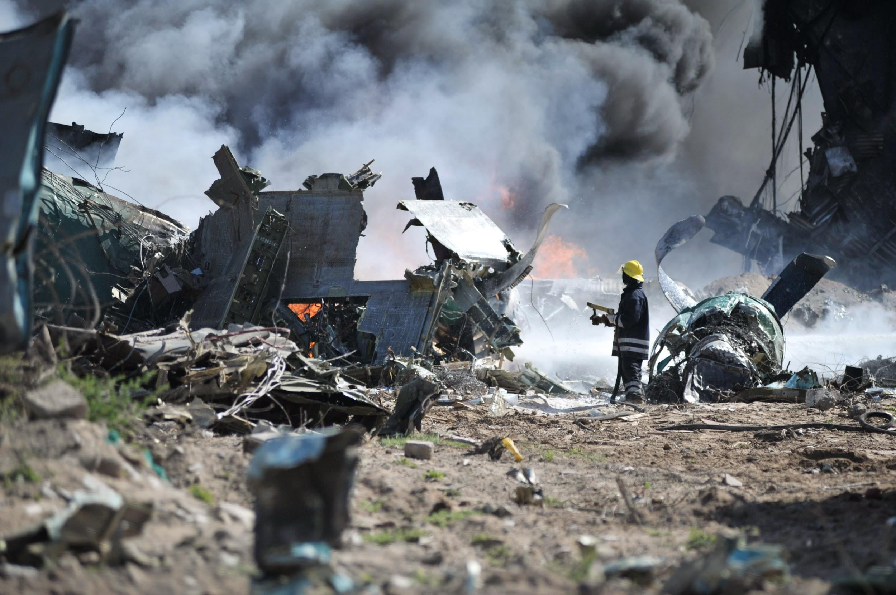
Not necesarily…

Slide 8

The Apache Software Foundation (ASF)
19 years building open source communities
Notes:
help projects thrive

Slide 9

The Apache Software Foundation (ASF)
Non-profit corporation
501(c)3 charity (USA)
Volunteer organization (member-based)
Virtual world-wide organization
Exists to provide organizational, legal and financial support for various OSS projects
The ASF is the open source software foundation with the largest number of projects and contributors.

Slide 10

ASF origin
Apache group
Informal corporate structure
8 members
Resumed the work on NCSA httpd in Feb 1995 (“a patchy” server)
Chose permissive licensing

Slide 11
Mission
Provide open source software to public free of charge

Slide 12
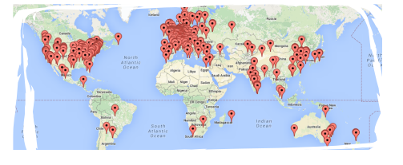
Evolution of the ASF
Before
Incorporated in 1999
21 members
2 projects
All servers and services donated
Now
~730 members
~320 projects (190 TLPs)
~6700 committers
~8000 signed ICLAs
Large and growing infrastructure

Slide 13
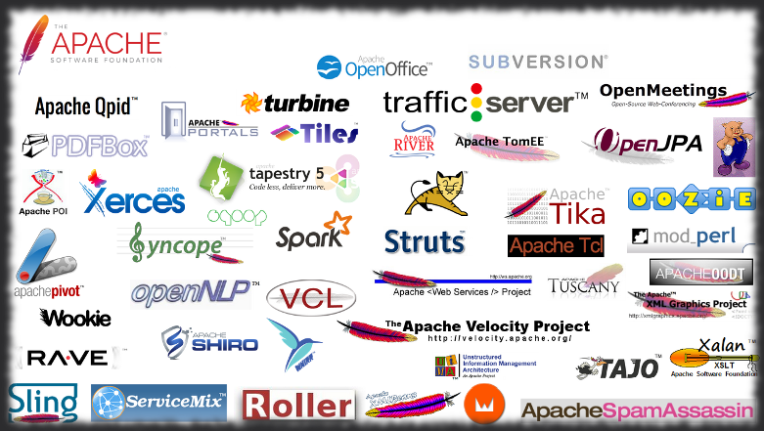
Some Apache projects

Slide 14
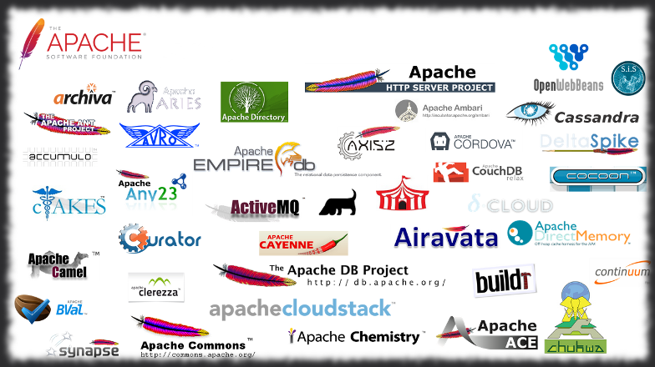
More Apache projects

Slide 15
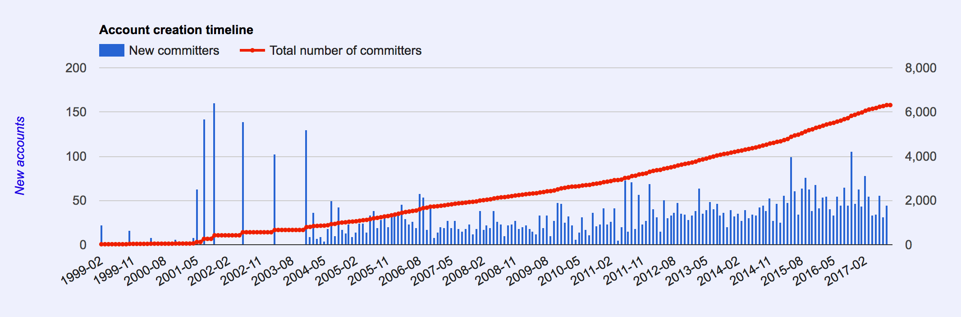
ASF growth - committers

Slide 16
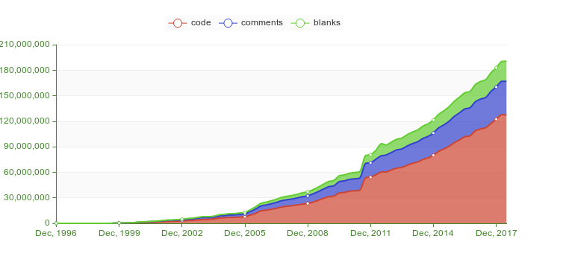
ASF growth - code

Slide 17
How to achieve the mission?
Provide open source software to public free of charge
Let the coders code - foundation deals with the rest
Infrastructure for open source development
Legal entity for donations, intellectual property (IP) and branding
Project governance and collaboration guidance

Slide 18
Infrastructure
ASF infrastructure is composed mainly by the following services:
Mailing lists
Web servers and wikis
Source code repositories
Issue / bug tracking
Communication tools
Distribution system (mirrors)
Notes:
Public record of communication and indexable = searchable. There are private mailing lists e.g. security, private project.

Slide 19
Legal
Legal entity for donation purposes (charity)
Apache license based copyright agreement (includes clauses to protect from patent litigation)
The project intellectual property (IP) is donated to the foundation which protects it against lawsuits, patent trolls, etc
Apache branding protection

Slide 20
Understanding governance and open collaboration following the life of a project in the ASF

Slide 21
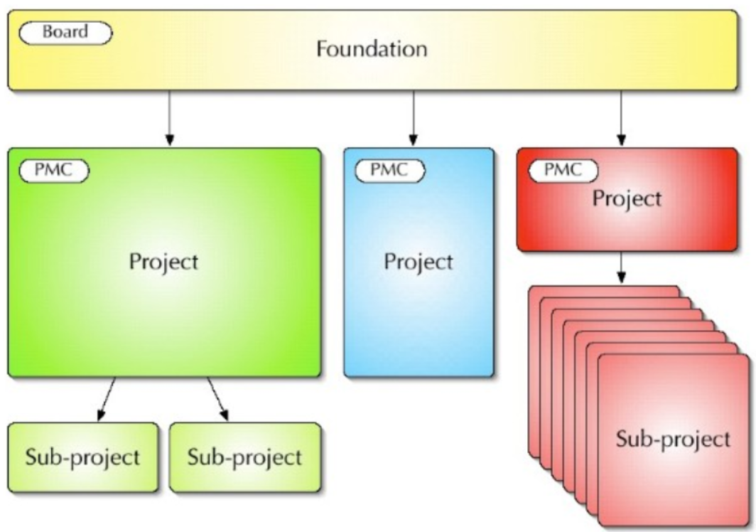
ASF structure
Notes:
No project hierarchy
PMC members elect PMC members
PMC members elect committers
Members elect members
Members elect the Board
Board appoints officers

Slide 22
Project Incubation
Entrypoint for all projects.
A project in incubation is called a podling
A committee of ASF members mentors the podling (PPMC)
Goals of incubation:
Ensure and track Intellectual Property
Learn about technical tools and procedures
Learn the Apache Way and open collaborative development (ASF principles)
Create first releases
A project with a healthy community gets promoted into a Top Level Project (TLP)
Note: Multiple projects working on a similar domain may be ok (not ideal but this evolves naturally).

Slide 23
ASF principles
Meritocracy
The Apache Way
Open collaboration
Community over code

Slide 24
Meritocracy
Govern by merit
Merit is based on what you do
Merit never expires
Those with merit get privileges but more responsibilities too
Merit does not buy you authority
Any constructive contribution earns merit
Not just code (bug reports, new feature ideas, documentation, evangelism, …)

Slide 25
The Apache Way
The Zen of Apache
Charity: Apache’s mission is providing software for the public good.
Community: Many of us are more effective than all of us.
Consensus: Getting good enough consensus is often better than voting.
Merit: Those that have proven they can do, get to do more.
Open: Technical decisions are discussed, decided, and available publicly.
Pragmatic: Apache projects use the broadly permissive Apache license.
* This is based in Shane Curcuru's interpretation of The Apache Way
Notes:
: Consensus-based, community driven governance

Slide 26
Open collaboration
Making open source is not equal to open development
Open communication matters
"If it didn't happen in the mailing list, it didn't happen"
Strong incentives to design and develop in the open
Peer based contribution and review
Shared vision
Self-service archives

Slide 27
Community over code
Contributors represent themselves - individuals
Trust and mutual respect
Every vote has the same value
A healthy community produces healthy code
A healthy community is “warm & inviting” and encourages a continued influx of developers
Final result: better code and better project in the long term

Slide 28
Code of conduct
1. Be open.
2. Be empathetic, welcoming, friendly, and patient.
3. Be collaborative.
4. Be inquisitive.
5. Be careful in the words that we choose.
6. Be concise.
7. Step down considerately.
Apache welcomes and encourages participation by everyone. We are committed to being a community that everyone feels good about joining.

Slide 29
Project normal lifecycle
Iterative development
Discussion on Mailing lists, issue tracking
Other tools (code review, version control systems, continuous integration, etc)
Commit Then Review (CTR) vs Review Then Commit (RTC)
Each project is free to choose its best practices and technical direction
Key point: Make governance only important for what it should be and to those who care

Slide 30
Vote and reaching consensus
Goal: The best ideas win and we agree on most of them
Coexistence rules (from experience and discussion)
Vote to reach consensus on new procedures, releases, important changes
Votes on releases (72h window). PMC votes are binding
Vote process. Express opinions and reach consensus
+1
-1 requires a clear explanation of why
[-1,1] different levels of agreement:
+0: 'I don't feel strongly about it, but I'm okay with this.'
+0.5: 'I agree but I am not totally enthusiast.'
-0: 'I won't get in the way, but I'd rather we didn't do this.'

Slide 31
ASF organization
Project
Foundation/Administrative
Project People
PMC Members
Members
Committers
Officers
elect
report quarterly
delegates
Contributors
Board
Users
Notes:
No project hierarchy
PMC members elect PMC members
PMC members elect committers
Members elect members
Members elect the Board
Board appoints officers

Slide 32
Project Management Committee (PMC)
Project Management Committee (PMC)
Vote for new PMC members and committers
Vote to release new versions
Establish project specific rules and report to the board
Oversees legal compliance and community health
Each PMC has a chair (appointed by the board) - eyes and ears of the board (oversight only)

Slide 33
PMC governance
Projects submit quarterly reports to the Board
Oversight focuses on avoiding anti-patterns
“Umbrella” projects
Undue commercial influence
Stagnating community
...and encouraging good things
Adding new committers and PMC members
Cutting releases
NOT concerned with technical issues

Slide 34
Projects fail or end and that's ok
Contributors change interests/priorities
Companies stop funding and no other people cares.
Projects do 'finish' or are considered 'complete'.
Apache projects get retired into the Attic for archive purposes.
Notes:
The Apache Attic project preserves the information for posterity, reference, and potential future re-activation, while keeping it clearly distinct from active work.

Slide 35
Board and ASF Members
Remember only volunteers
Member-based corporation - individuals only
Members nominate and elect new members
Members elect the board - 9 seats
Manage and oversees the corporation actives and resources
Board may intervene to resolve community conflicts
Annual online meeting
The board appoints 10 officers
Oversee day-by-day affairs, e.g. legal, fundraising, marketing, infrastructure, etc.

Slide 36
Some key lessons on community and software building the Apache way
Organisations can try and promote some of the Apache practices:
Light governance: facilitator role towards objectives.
Open communication: with archives.
Decentralization and participative consensus.
Meritocracy brings engagement.
Recognition is not only nice, it brings engagement.
A good ecosystem promotes naturally cross-project collaboration
Notes:
voto una empresa puede no funcionar con un voto abierto pero developers deben liderar el trabajo

Slide 37
Thriving to create living systems
A "Living System" is one that grows into its environment, by self-organizing around opportunities. Living systems can last for a long time, adapt well to change, and thus be highly successful. By contrast, "Planned Systems" tend to be fragile, poor at coping with change, and thus short-lived.*
* Social architecture by Pieter Hintjens

Slide 38
Learn more and participate
The Apache Software Foundation (ASF)
The ASF blogs - ASF FAQ
Apache Community Development - Mentor program
@TheASF on Twitter (or Facebook or LinkedIn)
If you have doubts or are just curious, please contact me. I will be around, or send me an email or twitter message.

Slide 39

Thanks!

